Slide 1
Pressure Sensor Measurement Website User Manual
Presenter：Juan Anthonio Salas
Date：2026/02/04

Slide 2





What is Pressure Sensor Measurement System ?
Pressure Sensor Measurement System is a pressure measurement system designed to acquire and display pressure data in real time using a pressure sensor connected to a computer via USB or Bluetooth.
This system is intended for testing, monitoring, and pressure data analysis, and it supports interactive graphical visualization to facilitate real-time observation and post-measurement evaluation.

Slide 3
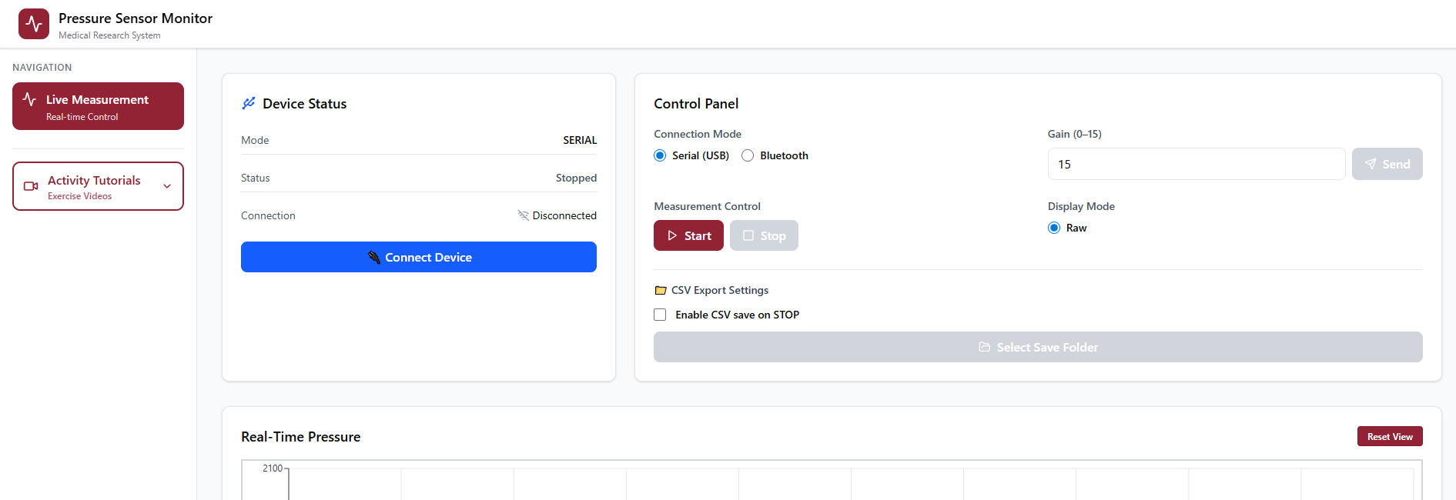
How to open the website ?
Go to the folder path, then type npm run dev in the terminal
Open a web browser and navigate to: http://localhost:5173/live

Slide 4
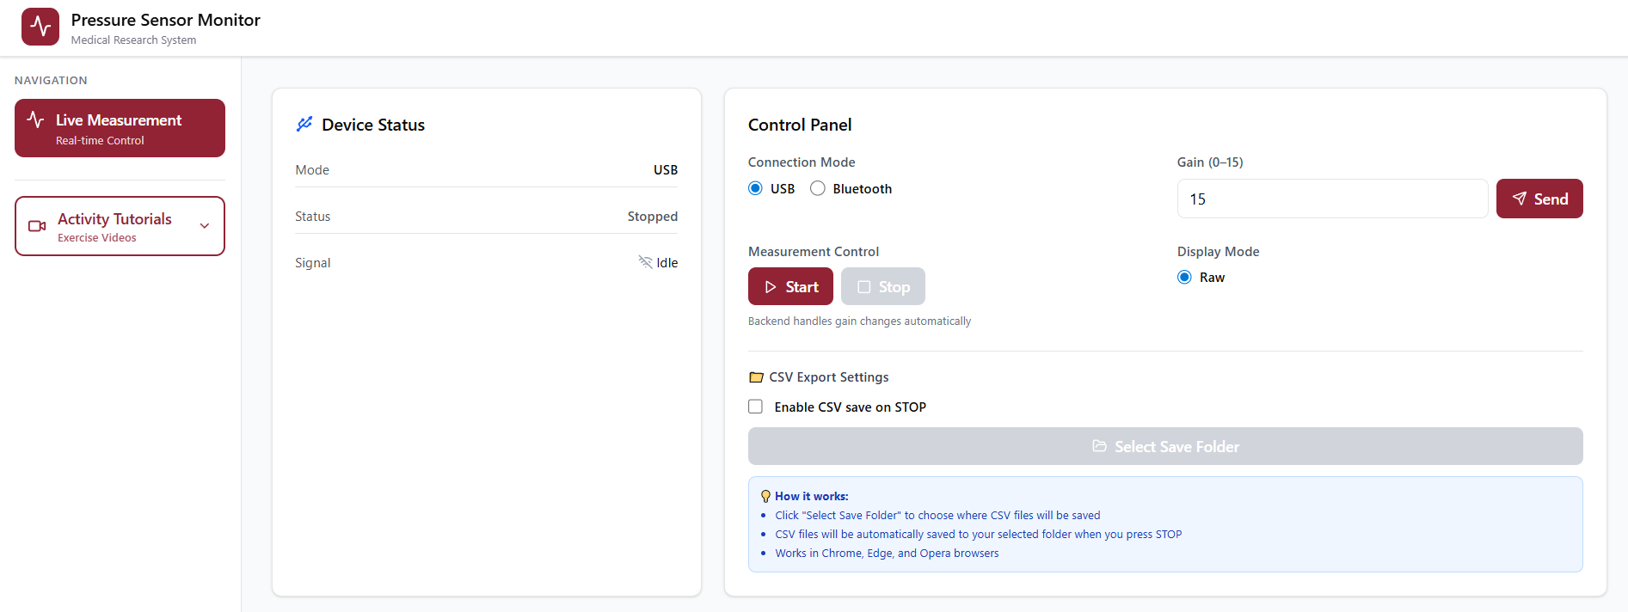
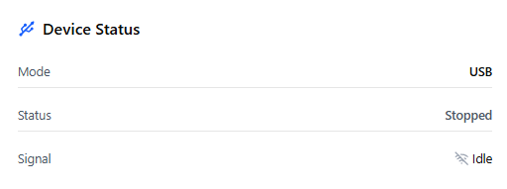
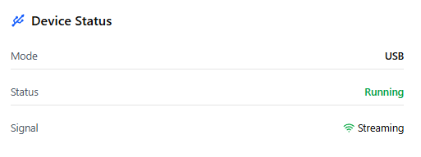
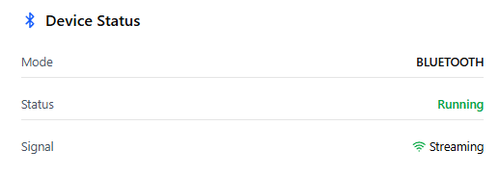
What inside the website ? – Device Status
The Device Status panel displays the current state of the sensor and measurement system.
Mode Shows the active connection mode (USB or Bluetooth).
Status
Stopped: Measurement is not running
Running: Measurement is active
Signal
Idle: No data is being streamed
Active: Sensor data is being received
This panel is read-only and updates automatically based on backend status.

Slide 5
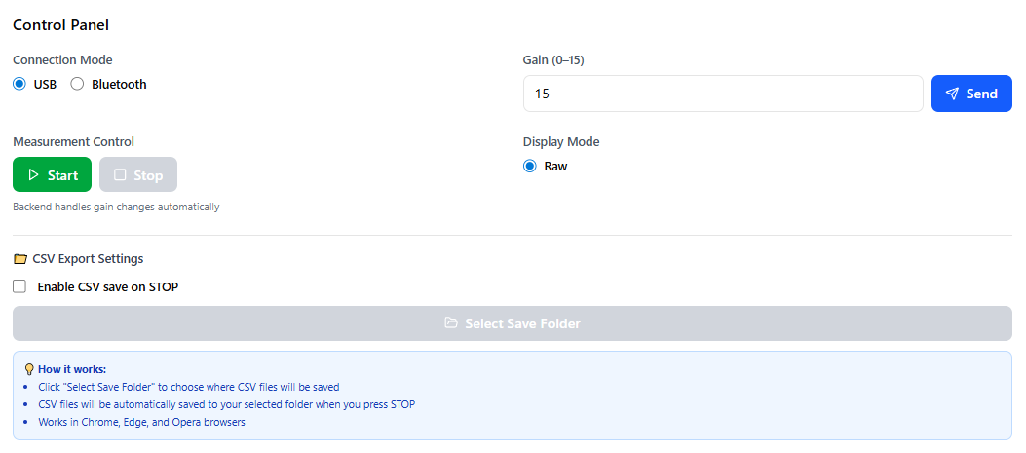
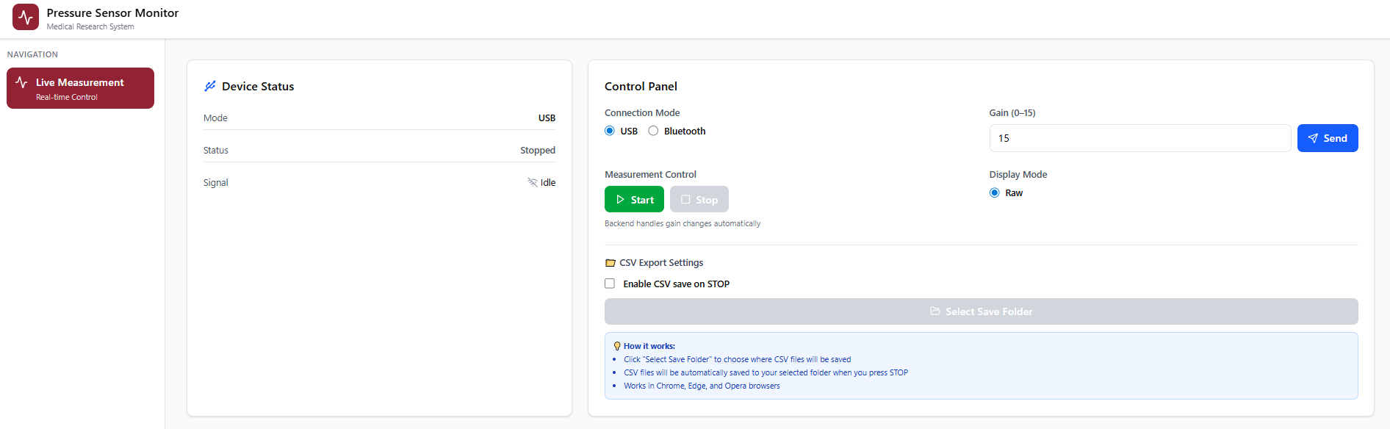
What inside the website ? - Control Panel
Connection Mode
Select USB or Bluetooth as the connection mode.
USB mode is recommended for stable and continuous measurements.
Bluetooth mode is optional and depends on device availability.
Start Begins real-time pressure measurement and data streaming.
Stop Stops the measurement and freezes the displayed data.
⚠️ Measurement must be started from this control panel. The system will not stream data unless the Start button is pressed.
Gain Setting
Gain (0–15) Enter the desired gain value and click Send.
Gain adjustments are handled automatically by the backend.
Higher gain values increase signal sensitivity.
Display Mode
Raw mode display pressure data directly from the sensor.(Currently the system only have 1 mode (Raw)
CSV Export Settings
This section allows automatic data saving when a measurement is stopped.
Enable CSV save on STOP
When enabled, the system automatically saves measurement data as a CSV file after pressing Stop.
Select Save Folder
Choose the destination folder for saving CSV files.
The selected folder will be used for all subsequent exports.

Slide 6
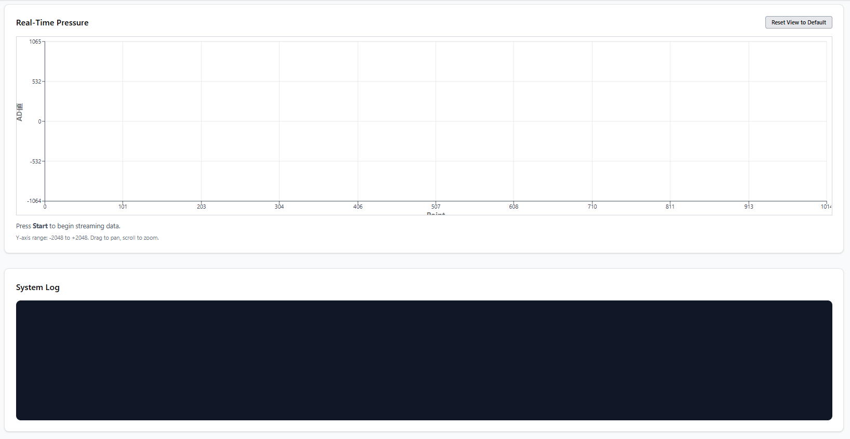
What inside the website ?
Real-Time Pressure Graph
Displays pressure data in real time during measurement.
The graph uses a sliding window:
New data appears continuously
Older data scrolls out of view
Reset View to Default
Resets zoom and pan to the default view.
Y-axis: ADC value X-axis: Sample index / time progression
System Log Panel
The System Log panel displays real-time system messages generated by the application. This panel is used to monitor system activity, user actions, and backend responses during operation.

Slide 7
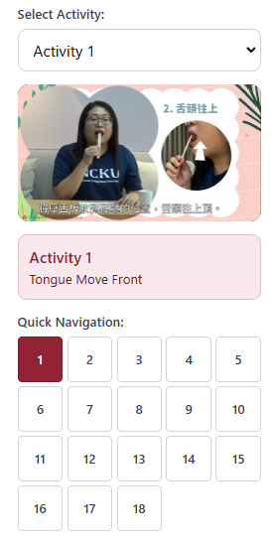
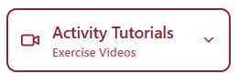
What inside the website ? – Activity Tutorials
Activity Tutorials
The Activity Tutorials section provides guided exercise videos that help users perform standardized the movement activities while using the pressure sensor system.
How to Access Activity Tutorials ?
Open the left navigation menu
Click Activity Tutorials
Select an activity from the Select Activity dropdown list.

Slide 8
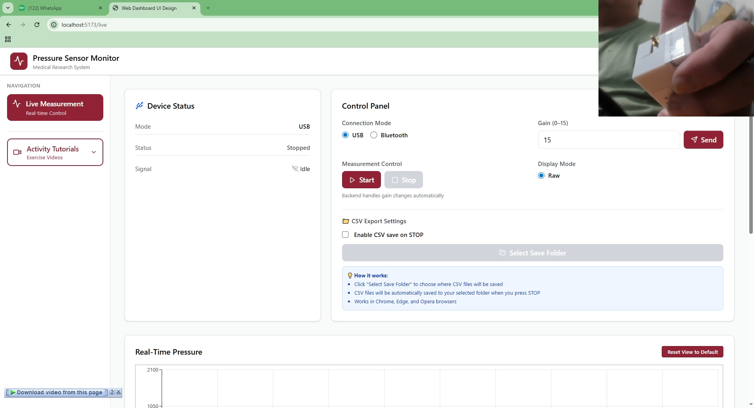
Live Measurement Demonstration (USB Mode)

Slide 9
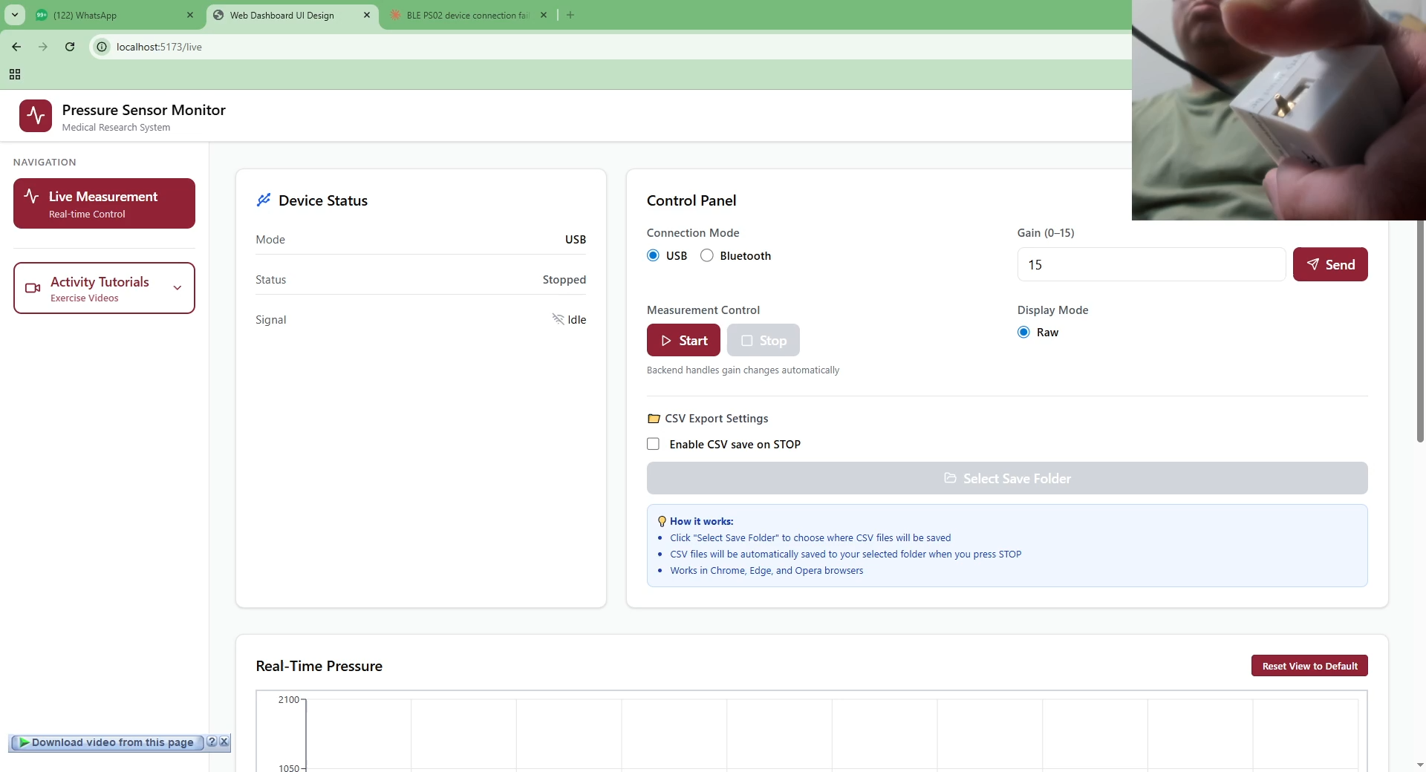
Live Measurement Demonstration (Bluetooth Mode)

Slide 10
謝謝 Thank You

